Slide 1


Interlacing the Globe
.
Panorama Exports Private Limited

Slide 2
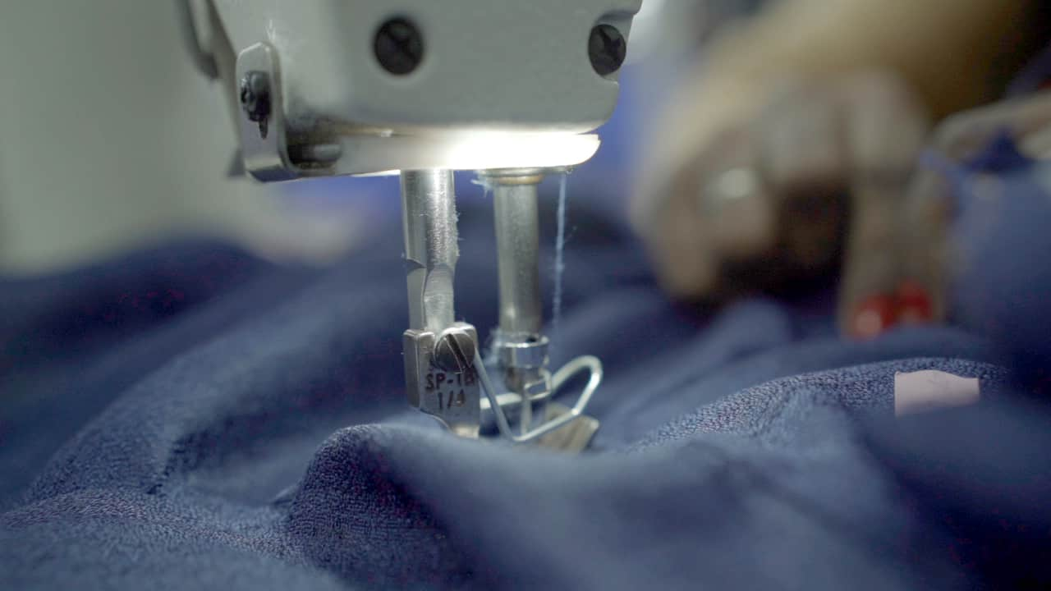

Thread
Legacy
Capturing the rich heritage and craftsmanship of Panorama.

Slide 3
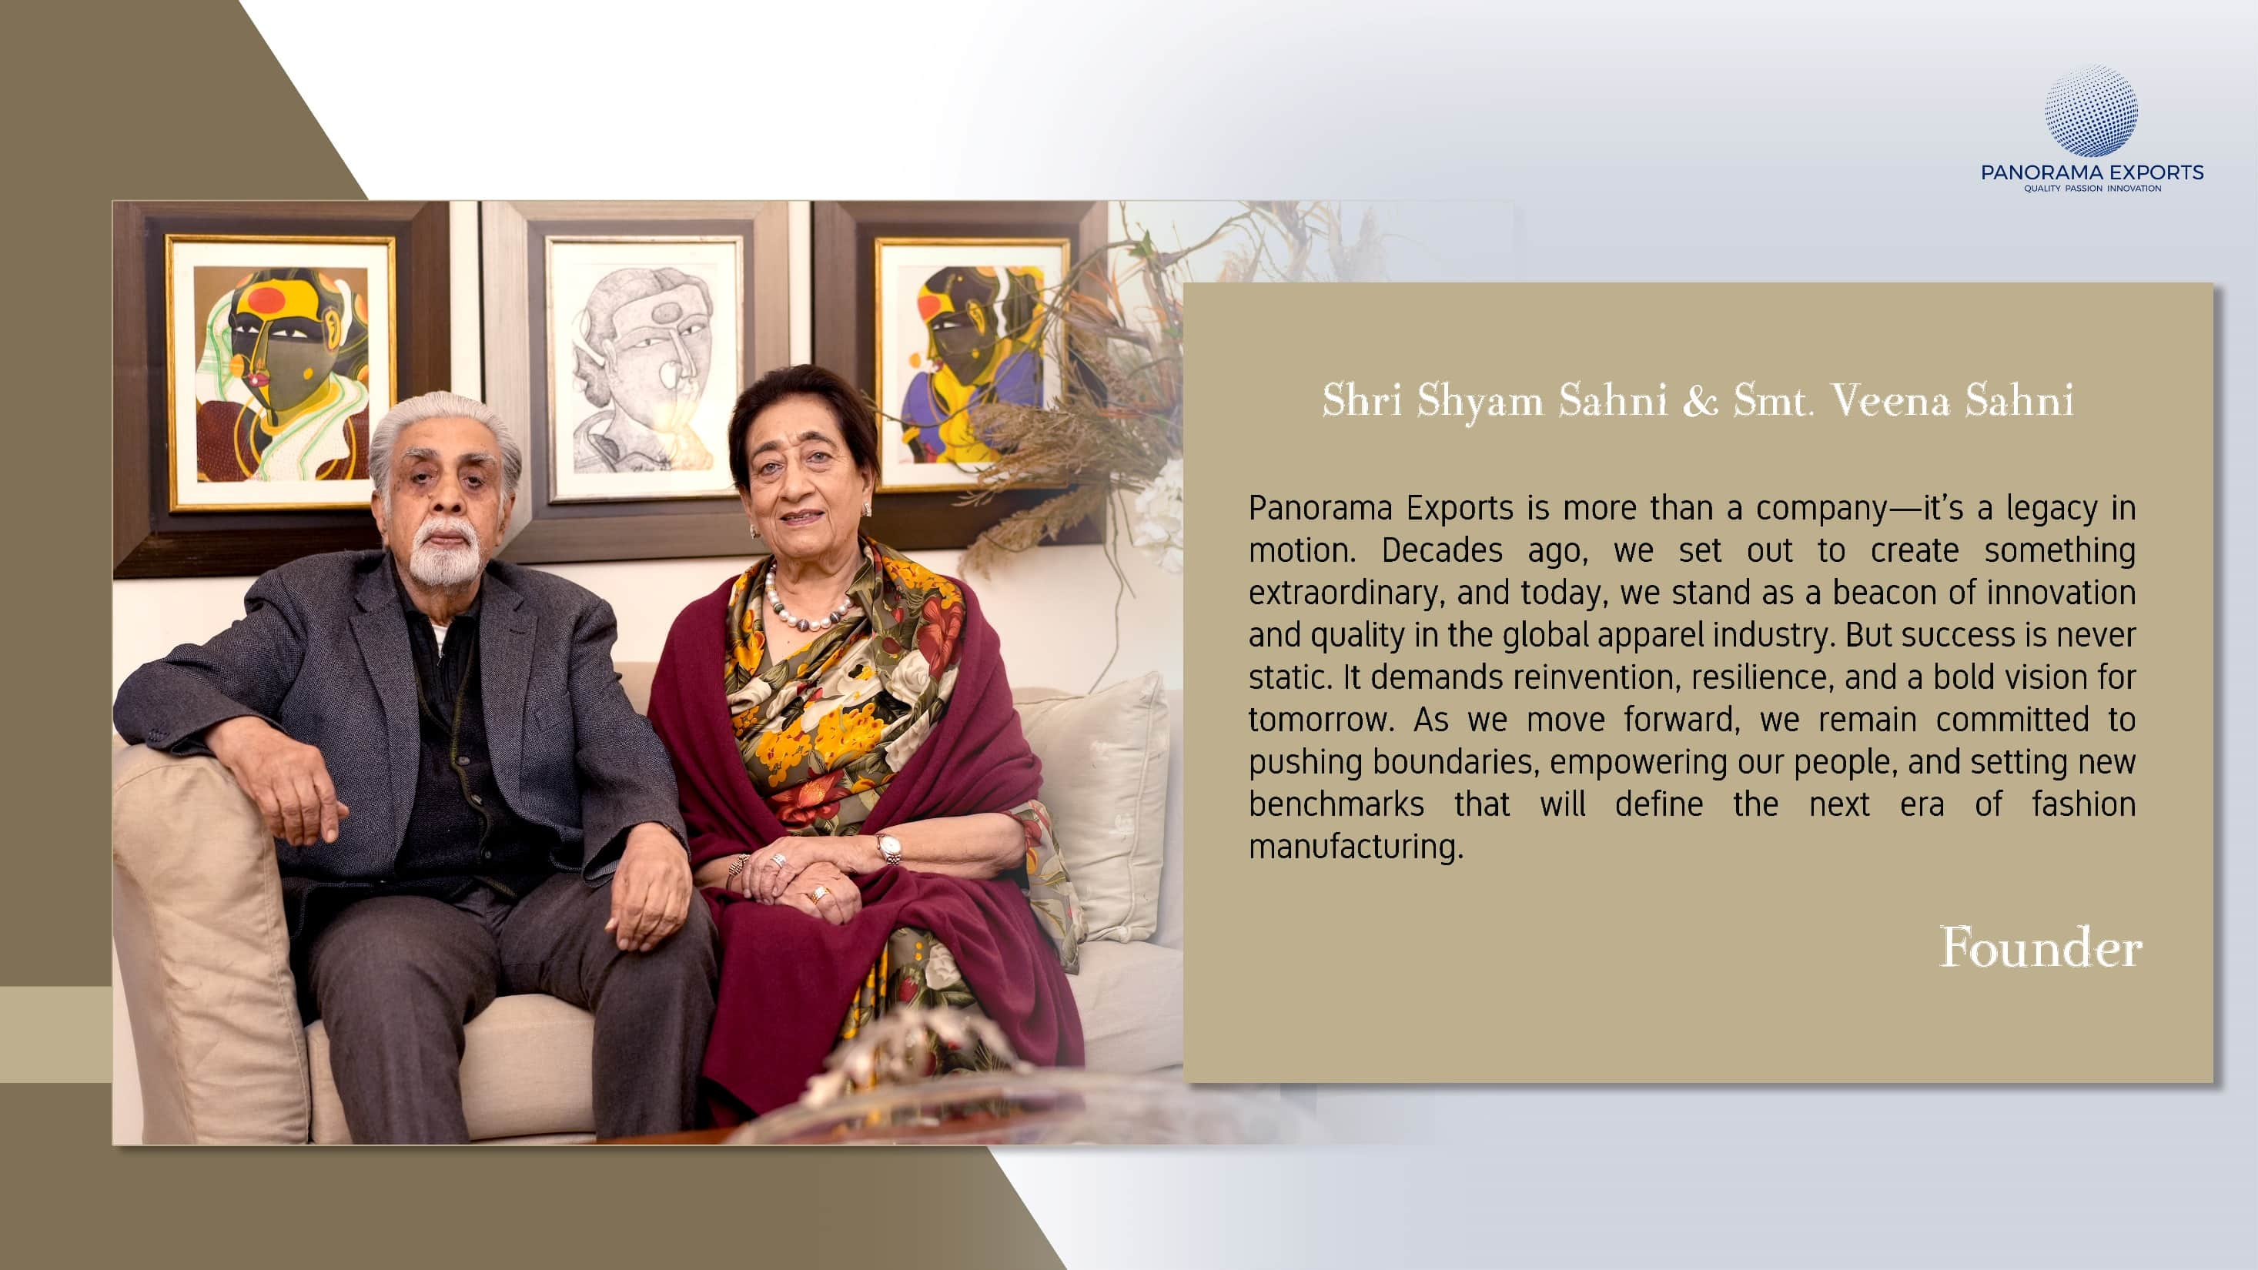
“Integrity isn’t just our foundation—it’s the fabric of everything we create”.

Slide 4


Woven
Innovation
From a modest beginning in 1973 to a global force in apparel manufacturing, Panorama Exports leads with innovation, sustainability, and an expand product range. Our vertically integrated factories, cutting-edge technology, and market-driven adaptability ensure superior quality and efficiency.
Committed to ethical excellence, we continue to shape the textile industry while creating lasting value for employees, customers, and stakeholders.

Slide 5

Mission
Panorama Exports Private Ltd. is dedicated to exceeding stakeholder expectations through innovation, operational efficiency, and a people-centric work culture, shaping the future of global apparel manufacturing.
Vision
To be the world’s most trusted apparel partner, pioneering cutting-edge technology, responsible sourcing, and forward-thinking design to redefine industry standards.

Slide 6





Journey to Excellence
Establishment in 1973
1973
2006
2022
2023
2024
Panorama Exports Pvt Ltd
Head office was established
Unit I started its process
Unit II started its Process
Panorama Warehouse
Unit III started its Process
Panorama Exports Private Limited

Slide 7


Slide 8
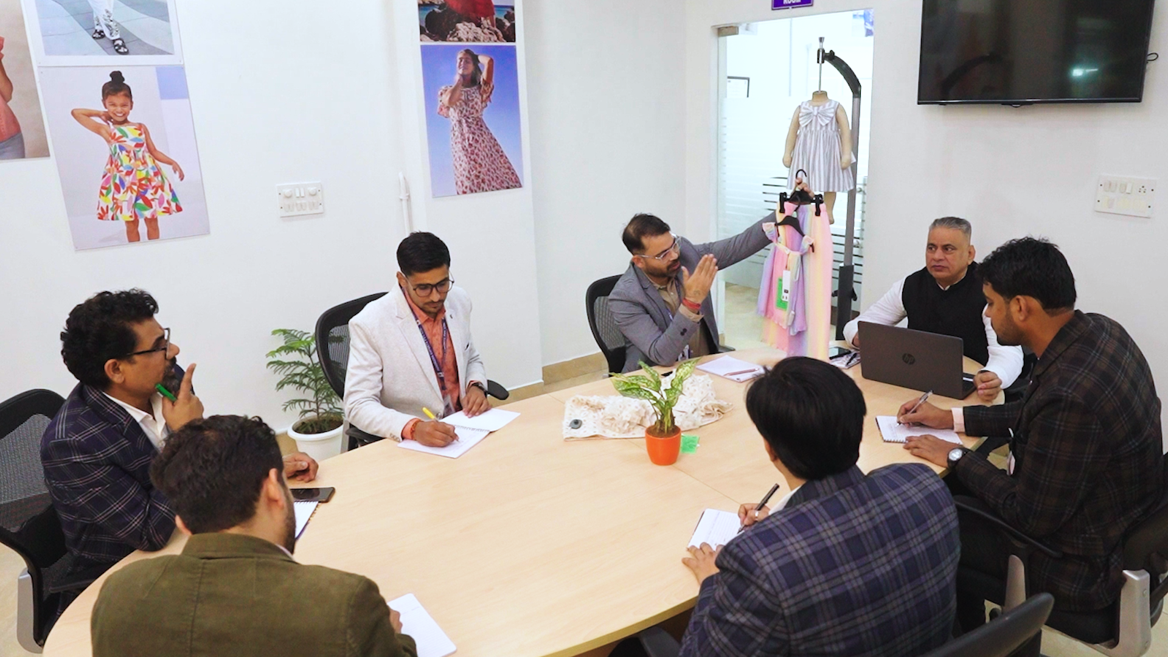
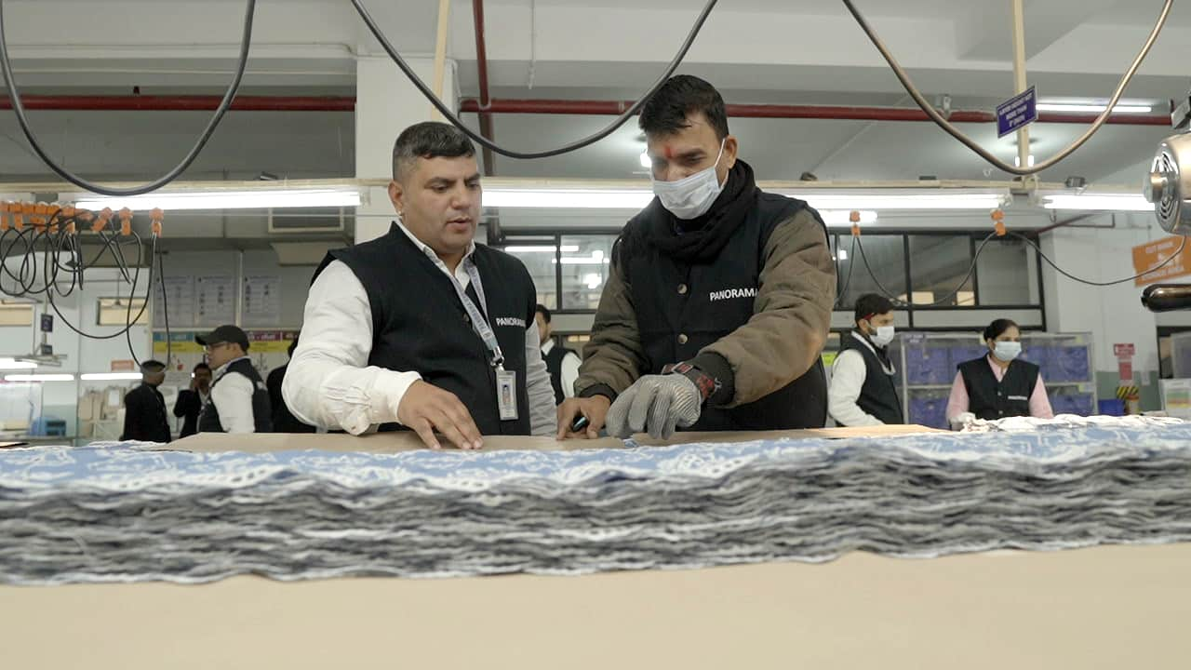
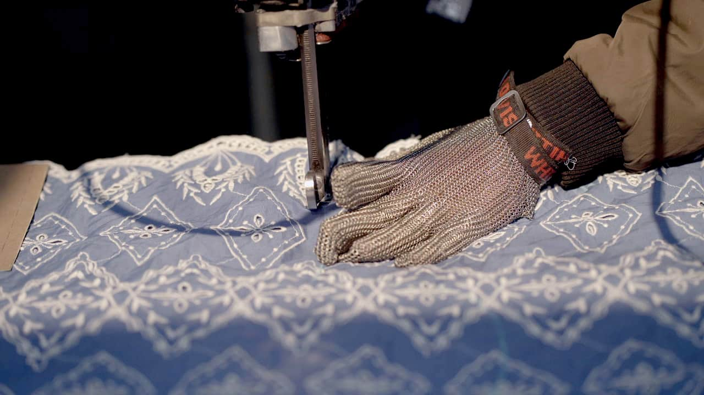
Harmonized Power
Panorama Exports thrives on a rare balance—where time-tested expertise meets youthful ingenuity. This synergy fuels our resilience, strengthens our partnerships, and propels us toward industry leadership. With passion and precision, our people drive the future of fashion.

Slide 9

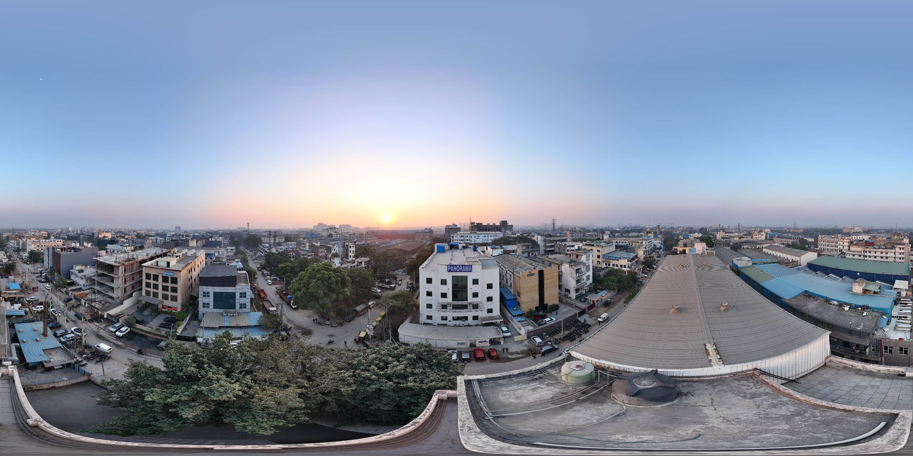

Slide 10
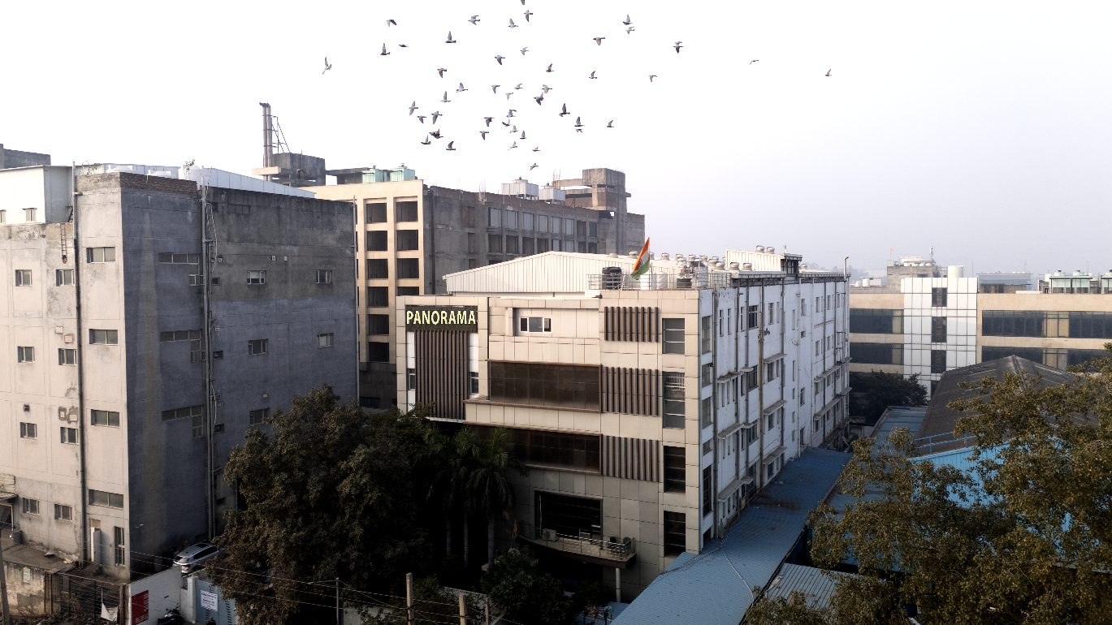
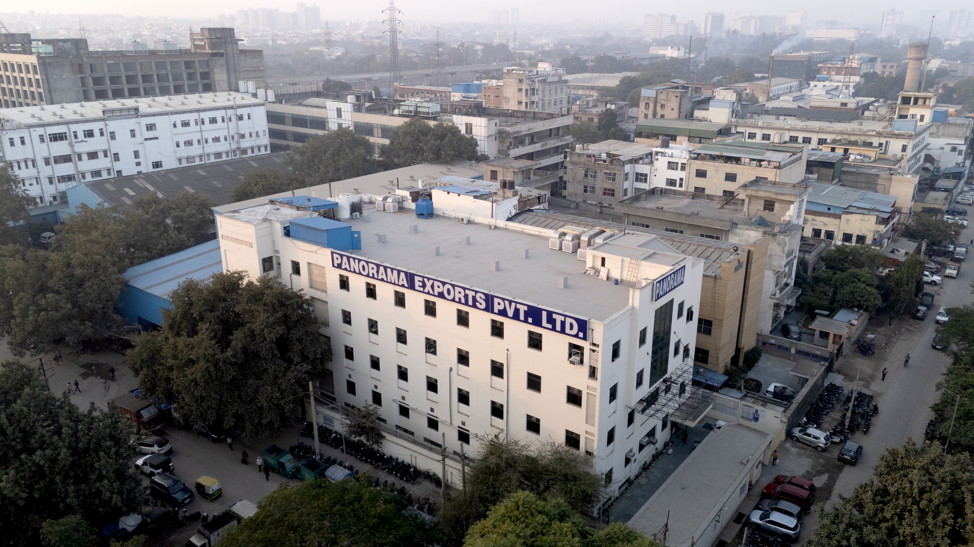
Manufacturing Units
Unit 01
Plot No 08 DLF Industrial Area Phase – I
Faridabad Haryana
Total Plot Area: 89136.47 sq. ft.
Unit 02
Plot No. 11 DLF Industrial Area – Phase I
Faridabad Haryana
Total Plot Area: 54906.14 sq. ft.

Slide 11
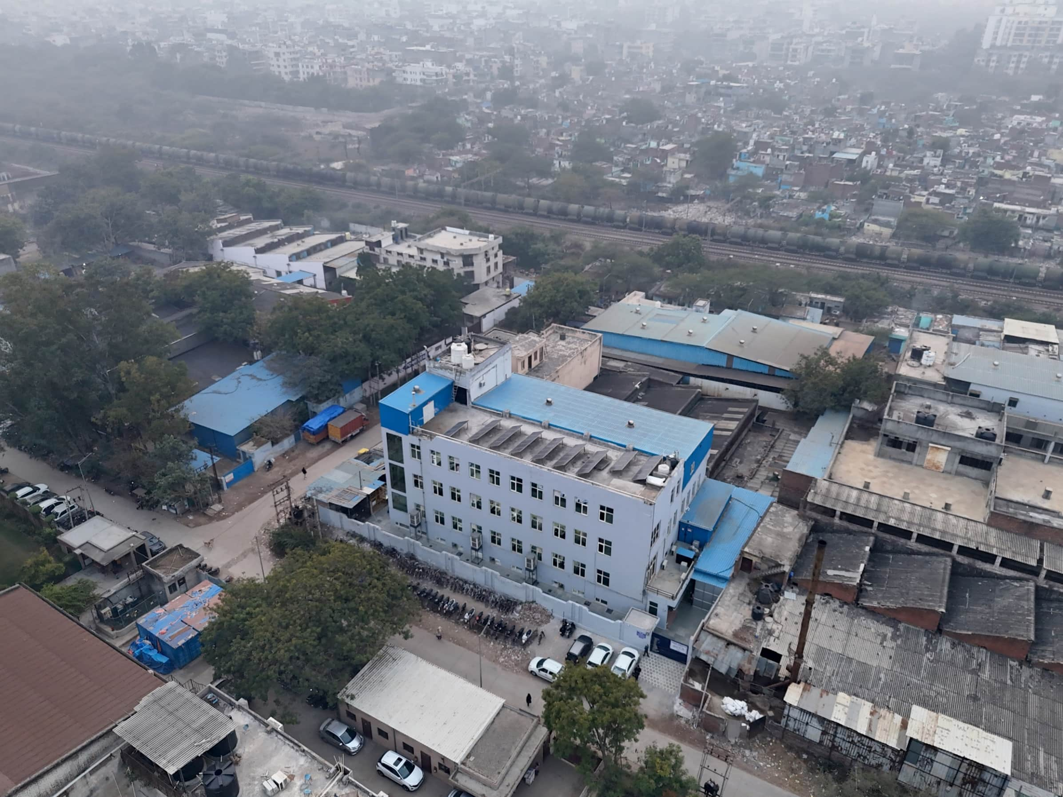
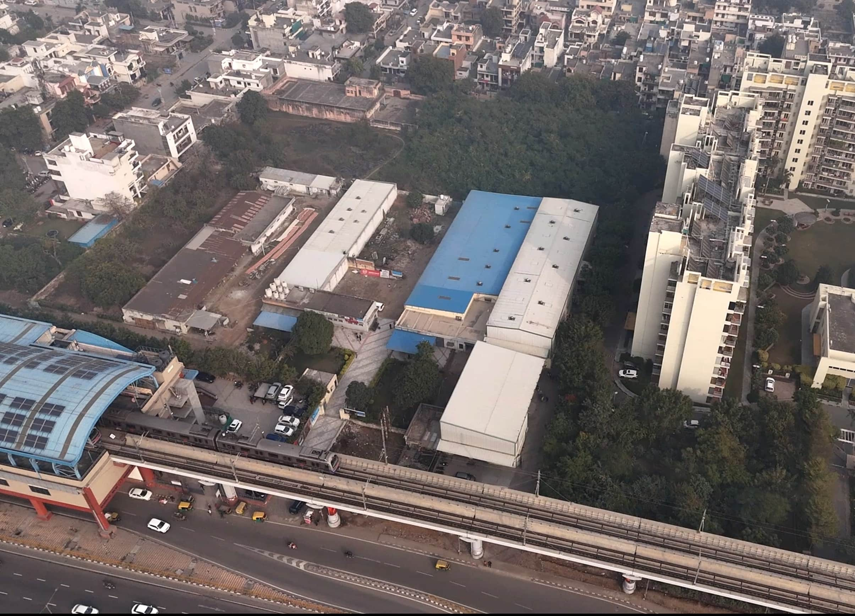
Manufacturing Units
Unit 3
Plot No 67
Sector 27C, Faridabad Haryana
Total Plot Area: 26990.96 sq. ft.
Unit 4
Panorama Warehouse
Plot No 16/3 Delhi Mathura Road
Faridabad Haryana
Total Plot Area: 18612.28 sq. ft.

Slide 12


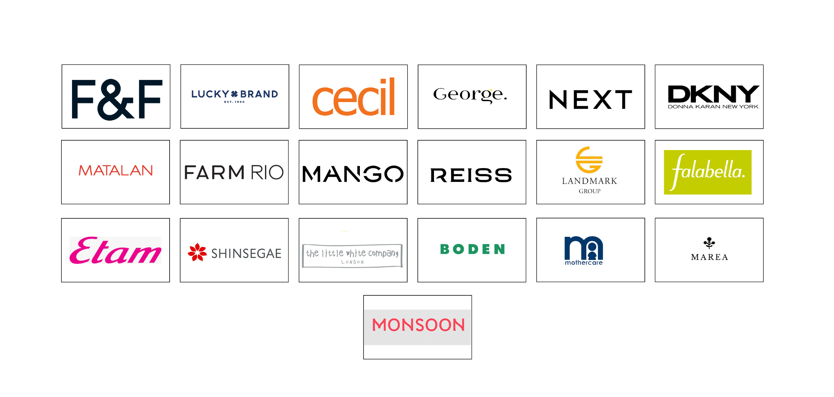
Global
Footprint
Panorama's presence extends to over numerous countries in four regions, establishing it as a significant global leader

Slide 13


Slide 14


Slide 15
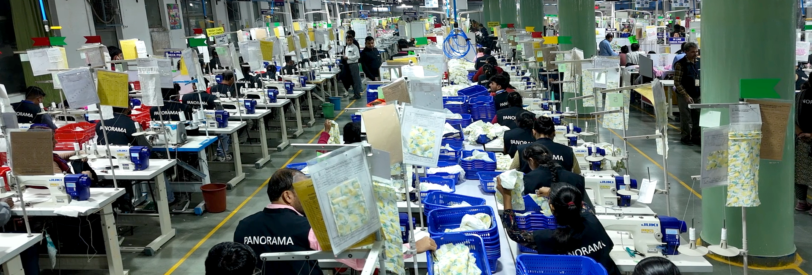
Capacity
Crafting 12 million garments annually—where precision meets scale.

Slide 16

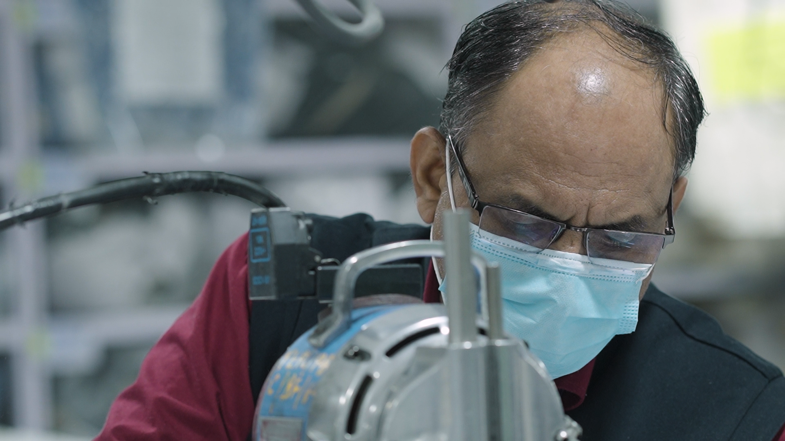

Our Workforce, Our True Asset
We believe that true change begins within. With a people-first mind-set, Panorama Exports nurtures a workforce of 5000+ employees—50% of them women, ensuring they reach their full potential. By championing inclusivity and empowerment, we shape a workplace that reflects our values and extends them to the world.

Slide 17
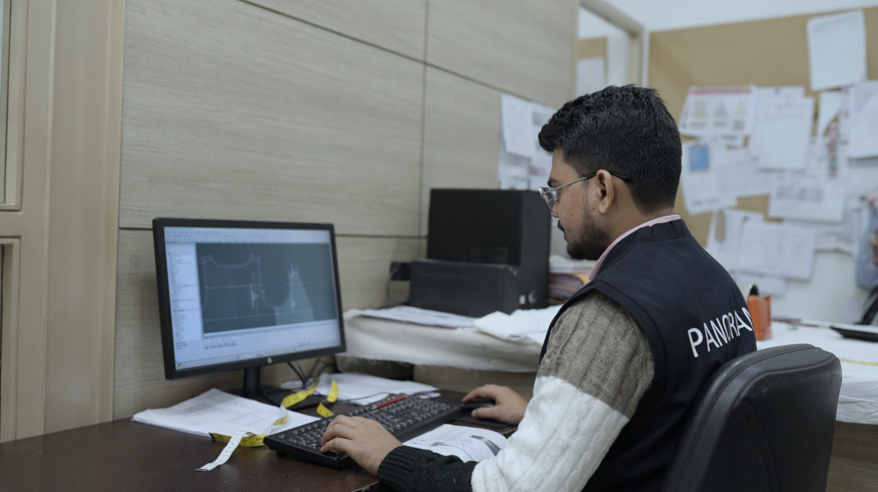
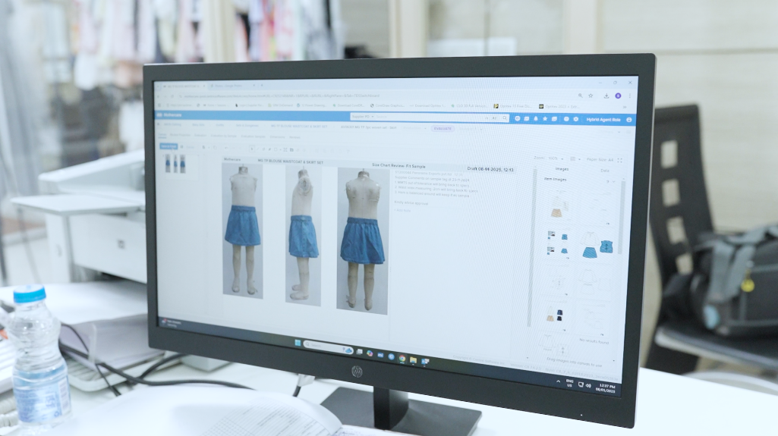
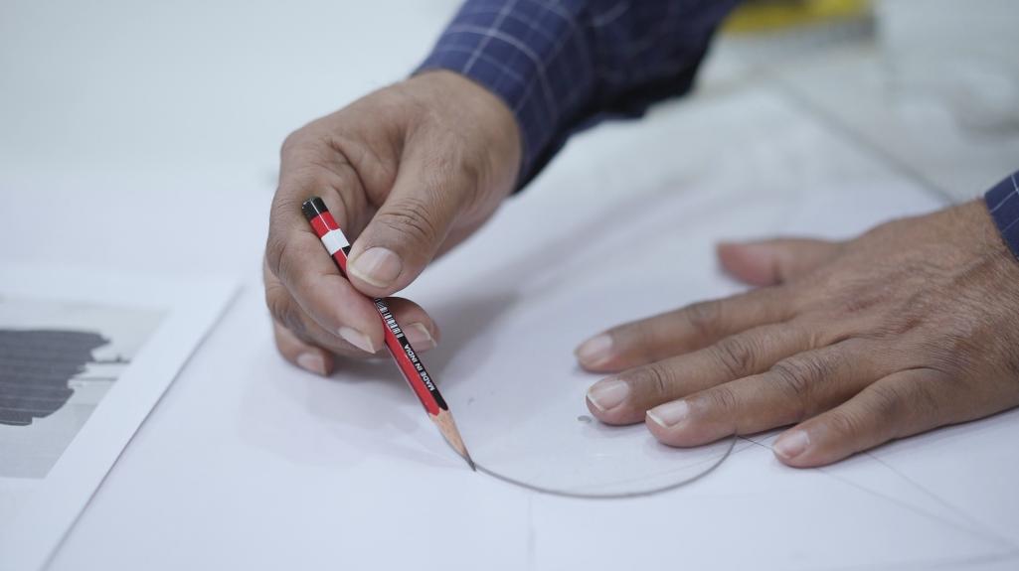
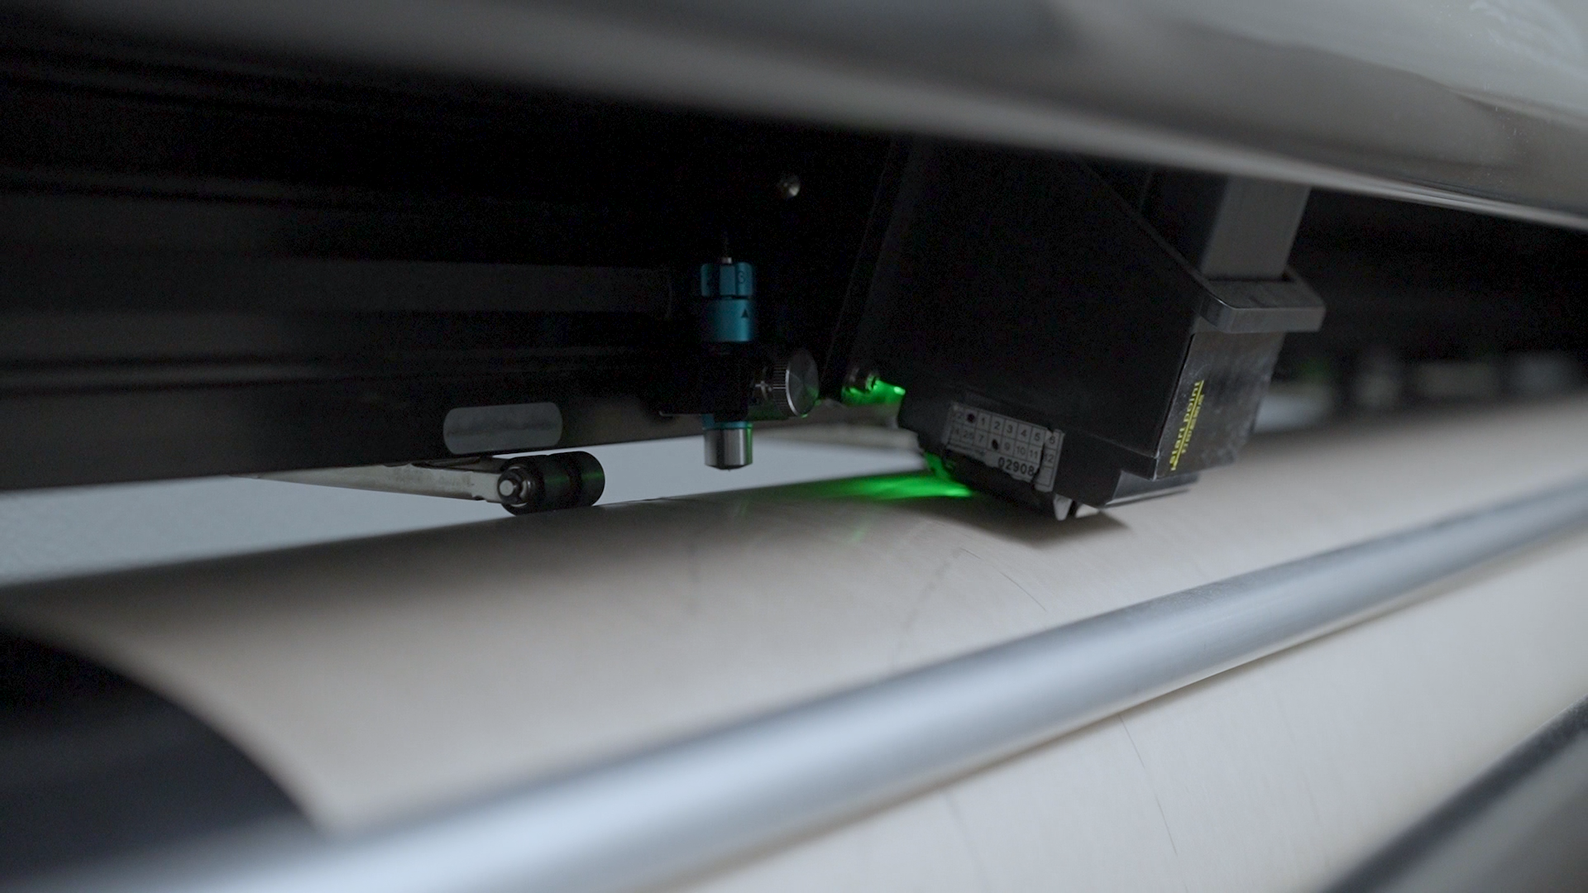
Blending Tech & Expertise in Fashion
Blending creativity with precision, Panorama Exports crafts designs that reflect client vision, market insights, and cutting-edge expertise. Our 90+ skilled designers drive innovation across CAD, 3D draping, sampling, textile advancements, and apparel craftsmanship.

Slide 18
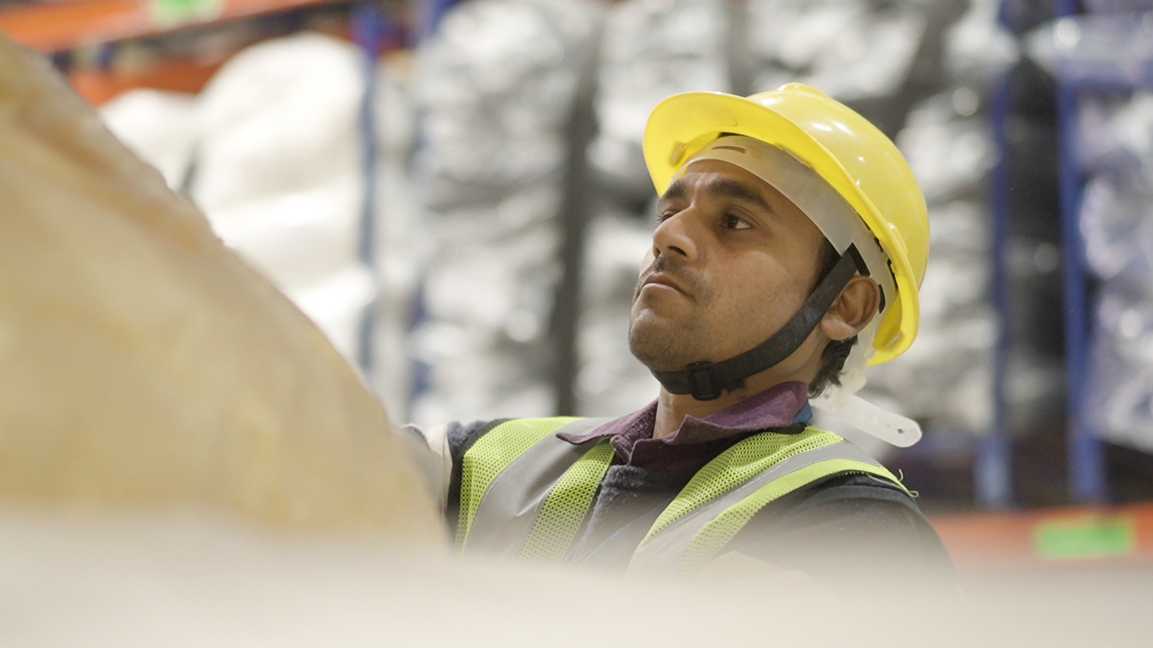
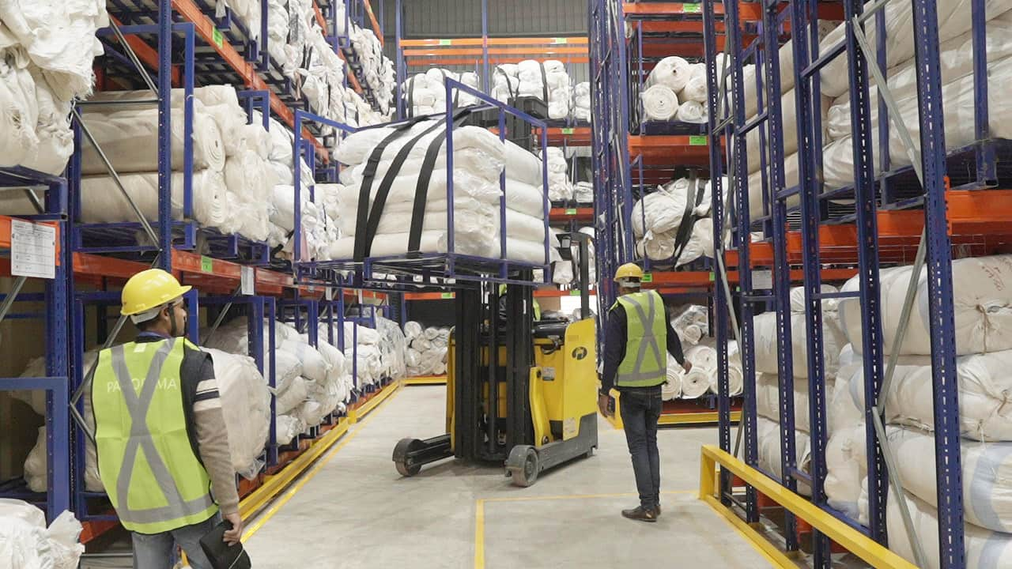
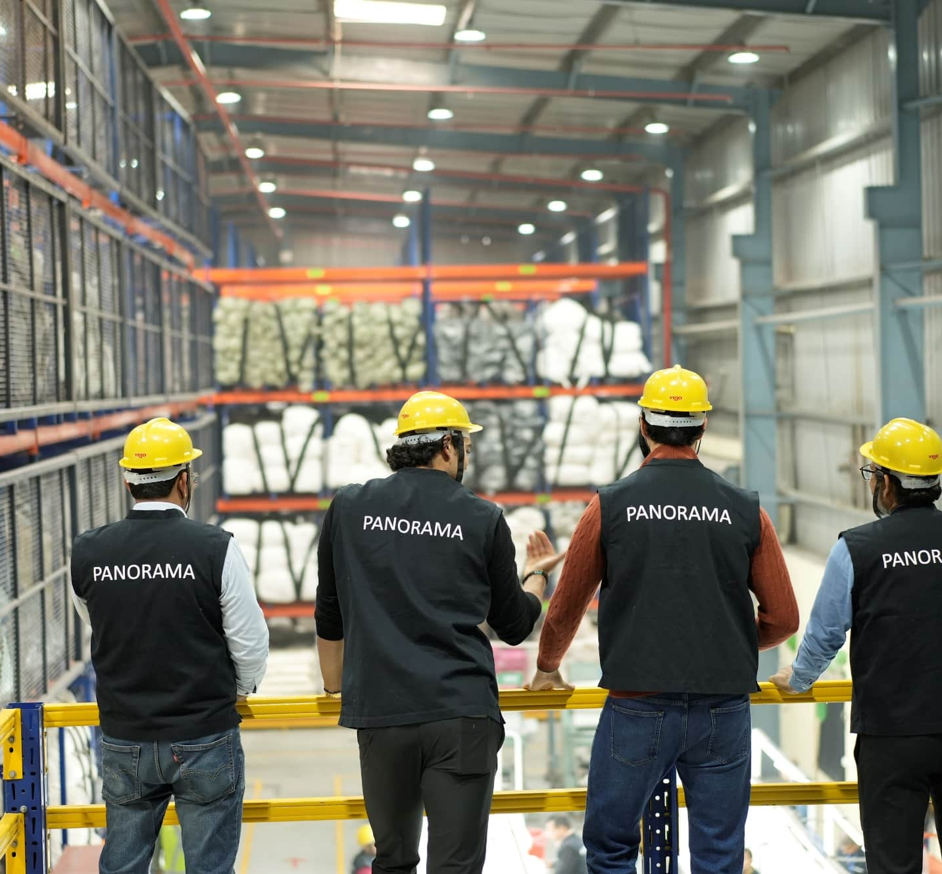
Precision in Motion
Panorama Exports leads with a cutting-edge automated warehouse, optimizing precision, quality, and efficiency through meticulous stock management and seamless operations.

Slide 19

Standards & Certifications

Slide 20
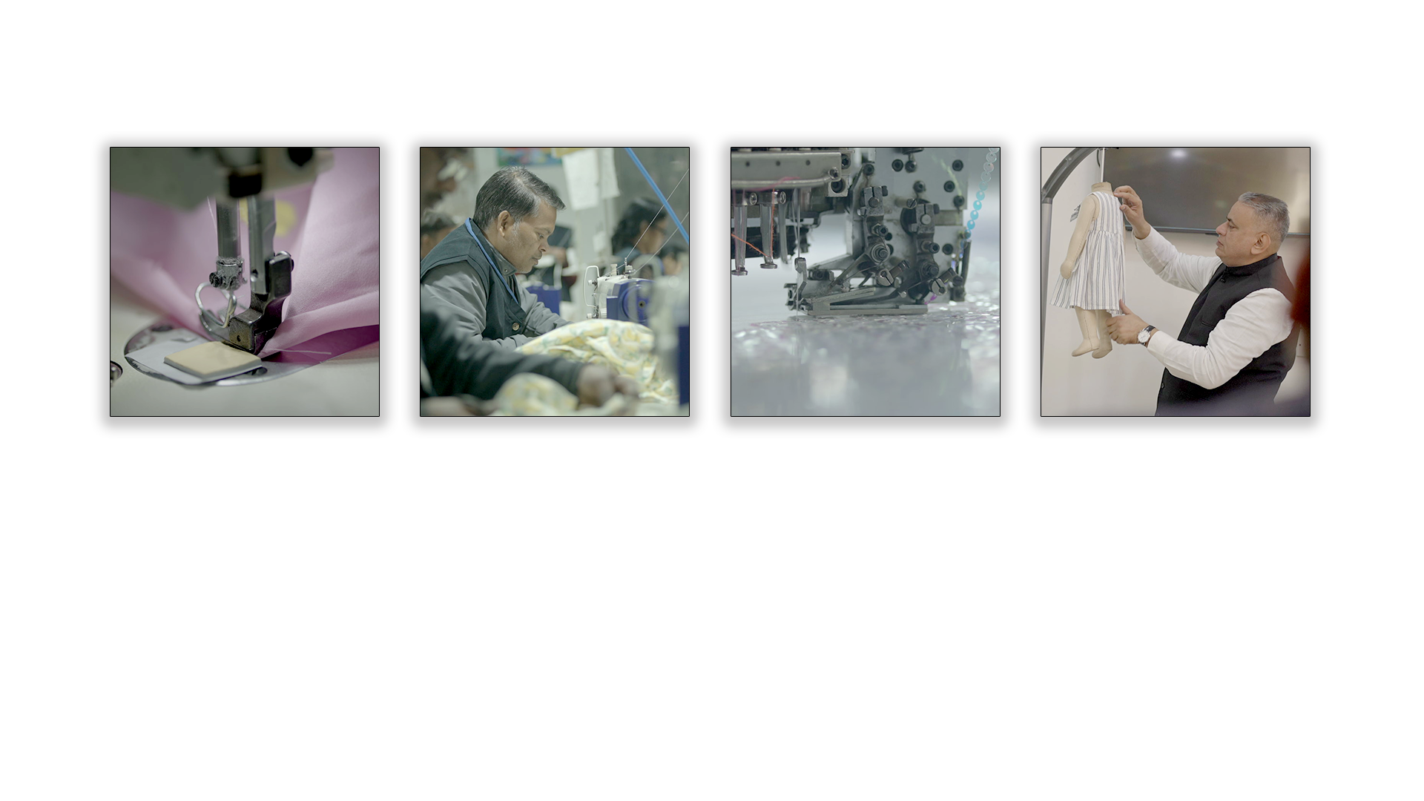
Manufacturing Mastery
With four high-tech cut-to-pack production units and one of India’s growing embroidery setup, Panorama sets new benchmarks in garment manufacturing.
Precision-driven quality control, lean manufacturing, and advanced wash expertise enable us to craft superior apparel—from timeless denim to revolutionary fabric innovations—all while championing sustainability.

Slide 21
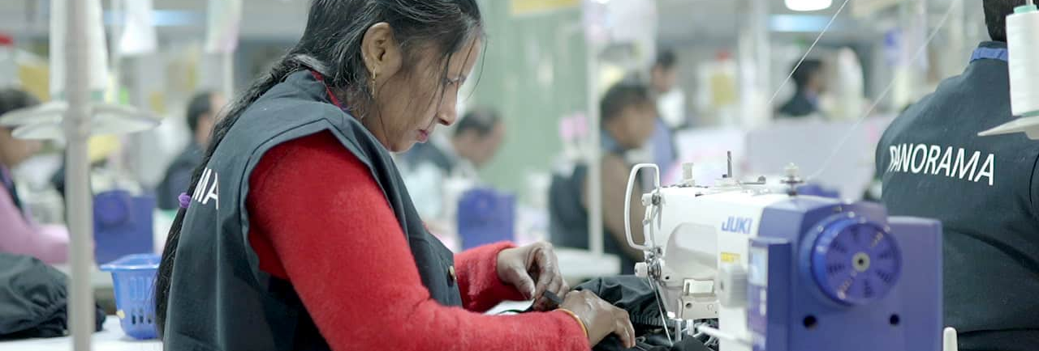
Becoming Future Ready
Precision in Motion: Leveraging Advanced UBT Sewing Technology for Superior Quality

Slide 22
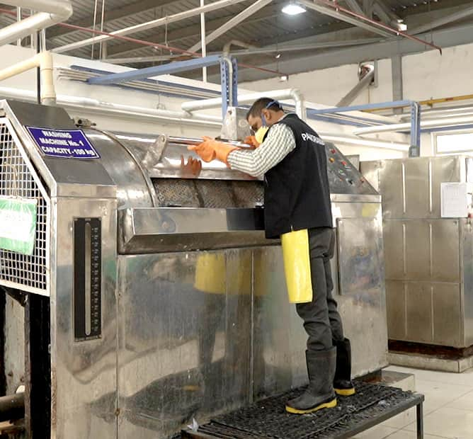

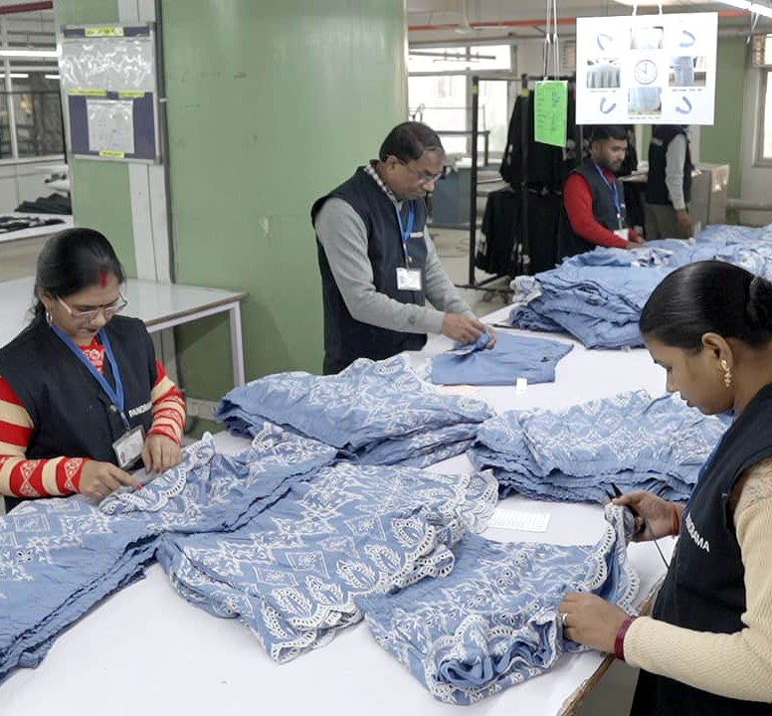
Sustainable Operation
Sustainability shapes our future, balancing progress with responsibility. Through strategic initiatives, we:
Lead in Climate Action
Empower Communities Economically
Ensure Fair and Inclusive Employment
Uphold Uncompromising Governance Standards

Slide 23


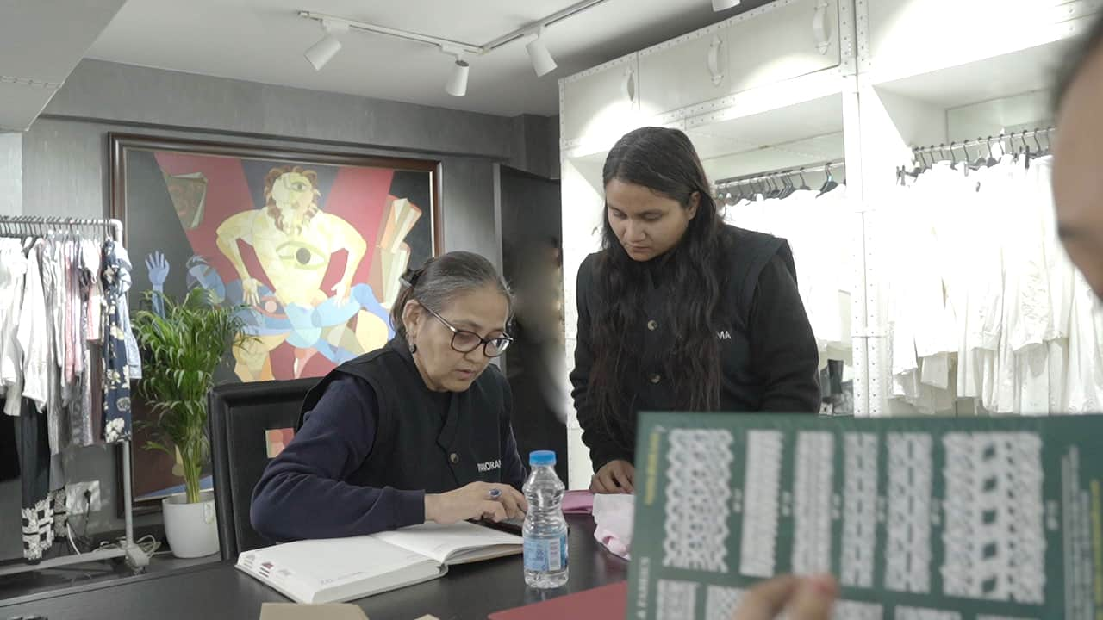
Crafting Careers, Elevating Potential
Panorama nurtures talent at every level, from fresh trainees honing their craft to seasoned professionals driving innovation. Our commitment goes beyond employment—we create an environment where safety, respect, and continuous growth define the work experience.

Slide 24
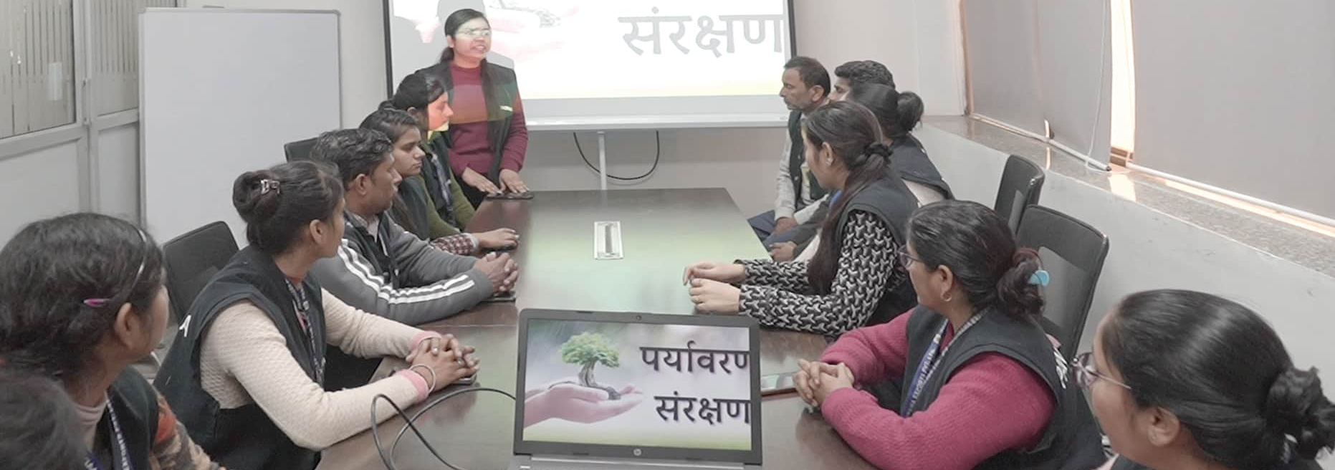
Efficiency Upgrade
Acknowledging employees as integral to its success, the company is devoted to furnishing them with the requisite skills to navigate technological advancements.

Slide 25
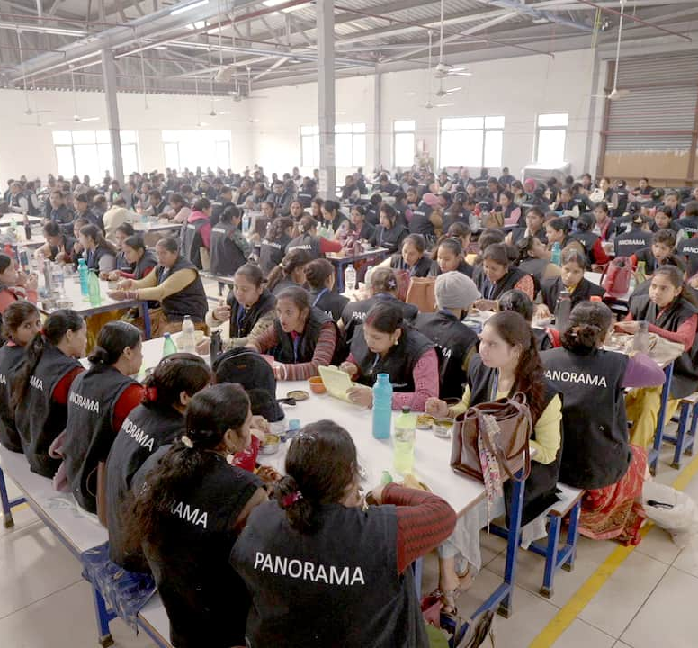
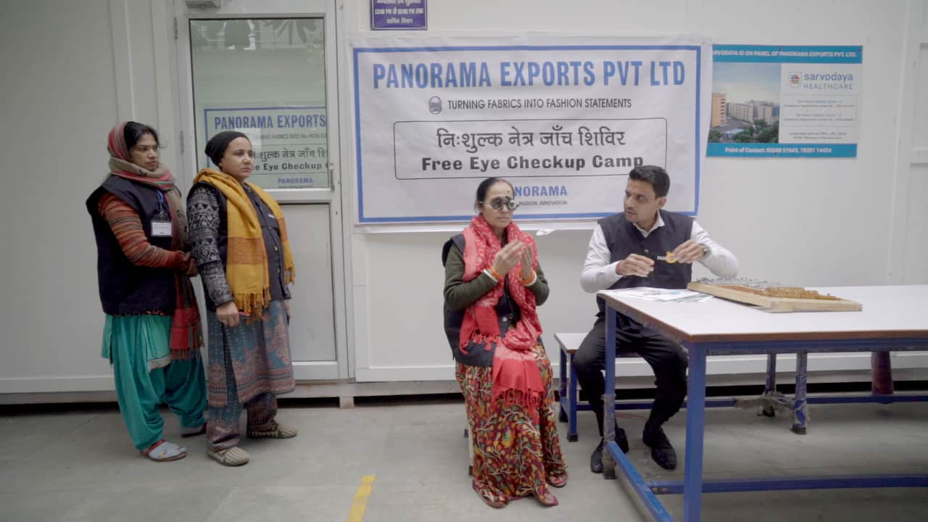
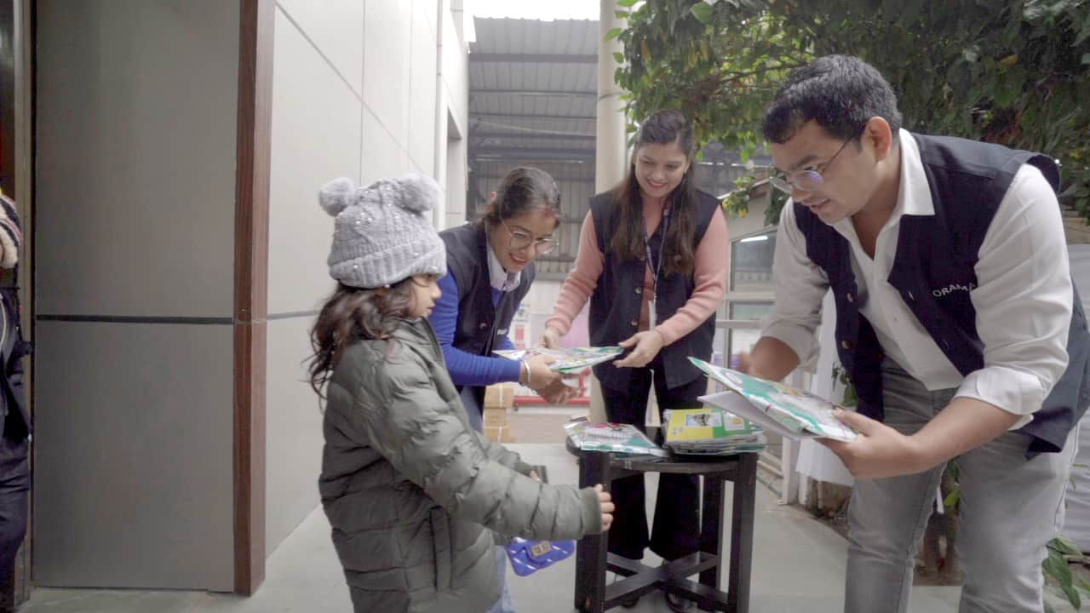
People. Progress. Purpose.
At Panorama, we cultivate a culture of responsibility, inclusion, and continuous growth:
Sustainable Stewardship: Innovating for environmental responsibility.
Safe & Thriving Workplaces: Fostering security and well-being.
Empowered Employees: Enhancing skills for personal and professional growth.
Health & Wellness: Strengthening awareness and preventive care.
Ethical & Fair Workplace: Upholding dignity, human rights, and grievance redressed.
Impact-Driven CSR: Driving change in education, healthcare, and sustainability.
.

Slide 26
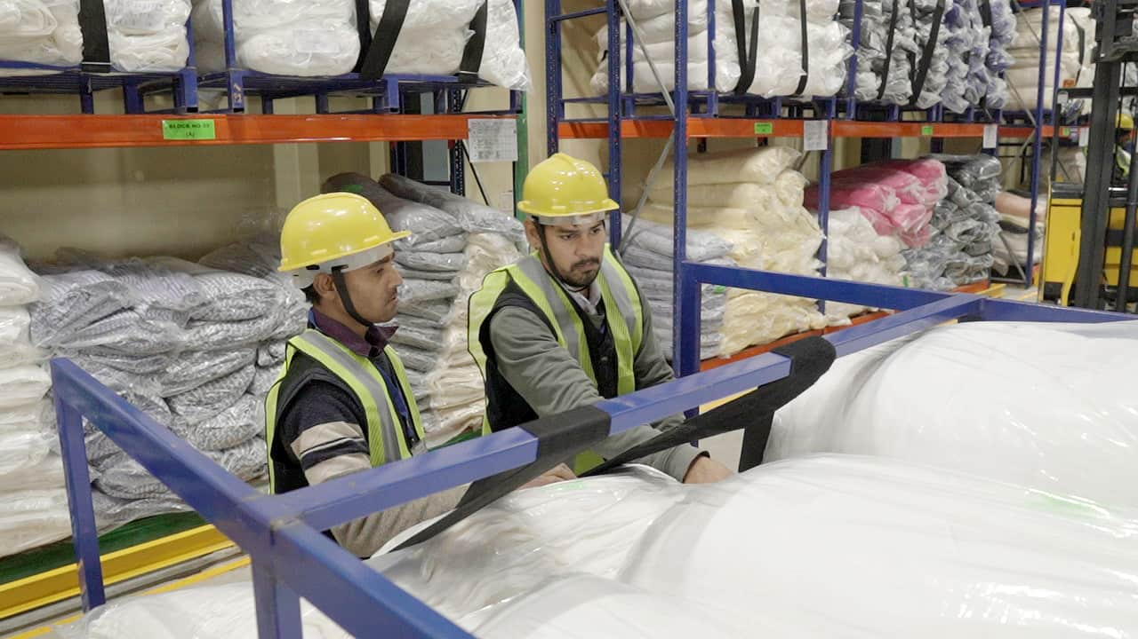

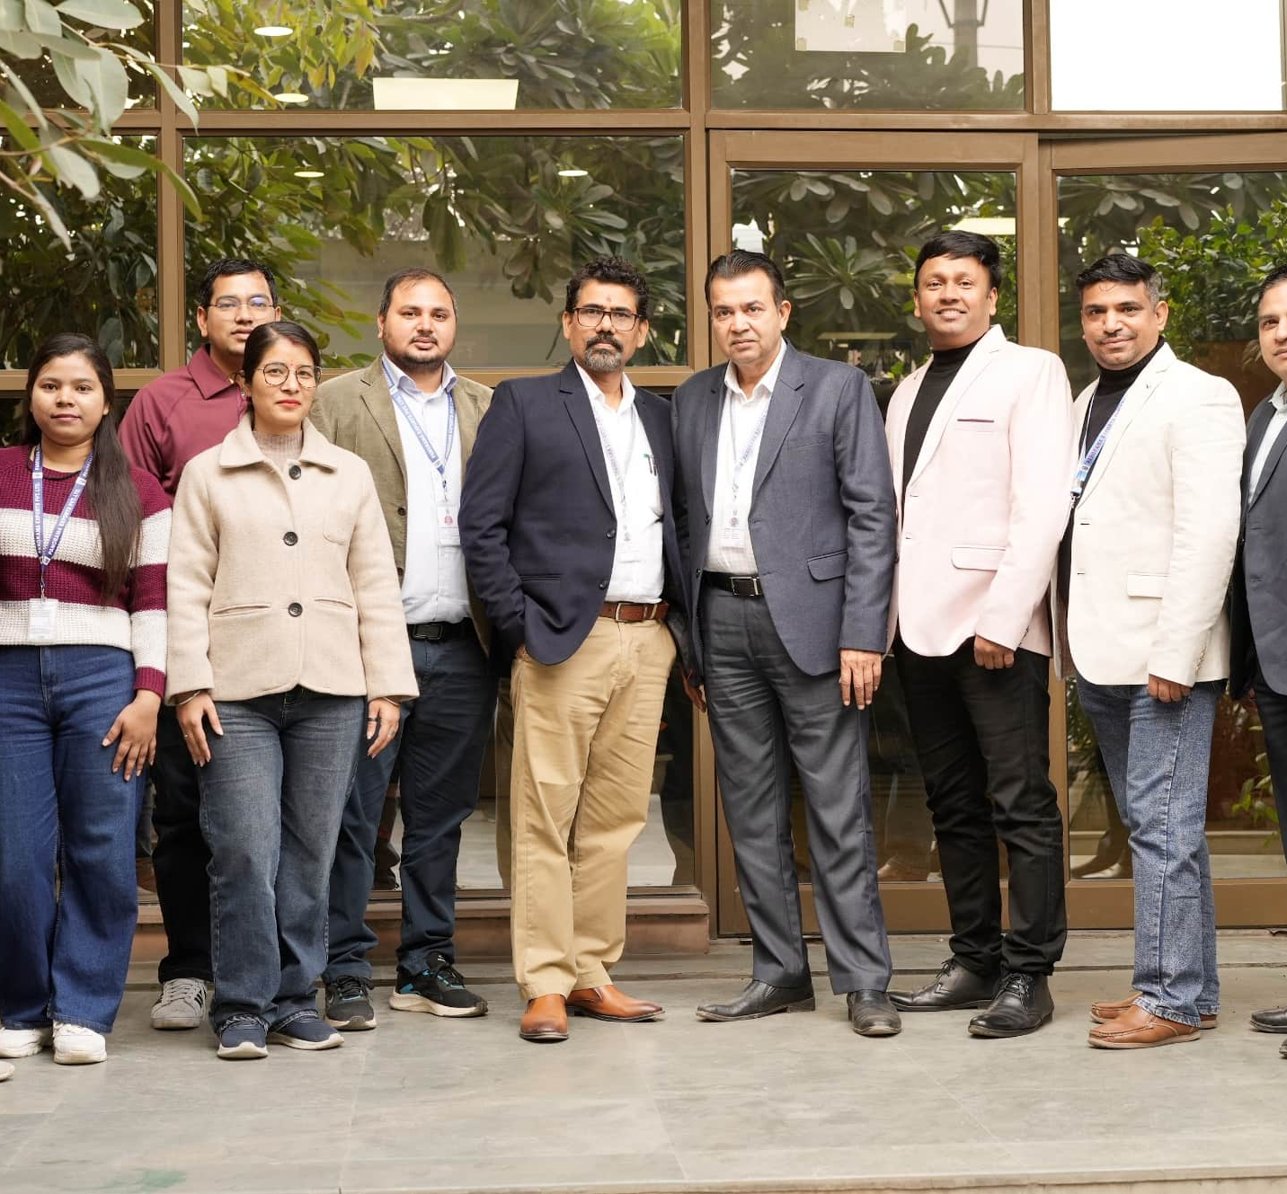
Health, Safety & Compliance
Panorama fosters a culture of accountability, ensuring rigorous compliance with global labour laws, buyer mandates, and ethical business practices. Our unwavering commitment to workers’ rights and brand protection is anchored in:
Ensuring Workplace Safety & Fair Wages
Promoting Equality & Zero Discrimination
Banning Child & Forced Labour
Maintaining Ethical & Safe Working Conditions
We take a firm stand against workplace misconduct, reinforcing a zero-tolerance approach to harassment, discrimination, and exploitation—upholding dignity, respect, and fairness for all.

Slide 27


